Slide 1

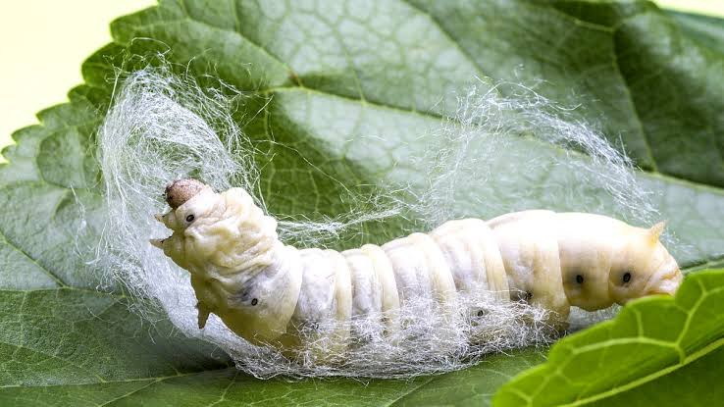
GOOD ENVIRONMENT FOR SILKWARM PRODUCTION
GSSS_TITANS(VISH20192058)
TEAM DETAILS:
M.SASIKANTH REDDY(TEAM LEADER)
C.GANESH
S.SHYAM SUNDAR
K.SHAHISTHA
MENTOR: Dr. SHANMUGA KUMAR

Slide 2
PROBLEM:
Silkworm larvae need constant climatic conditions like temperature, humidity, air quality.
The climate change affects farming significantly. In sericulture the climatic condition within the shed plays major role during incubation period of the silk.
Its very hard to achieve required environment for better larvae growth using local process.
For good environment we need to maintain the temperature between 23°C to 27 °C with humidity of 70% with air quality(400ppm).
The main problem is to maintain the temperature inside the silk warm shed in winter .

Slide 3
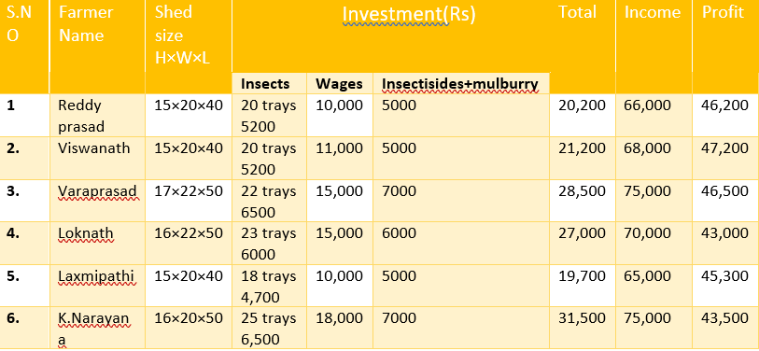
Feedback before implementation our project
Silkwarms get affected by diseases like grasserie, flacherie, muscardine and pebrine.
Silkwarms are affected by these diseases due to feeding of contaminated mulberry leaves and mainly changes in environmental parameters like temperature,humidity and Airquality.
Diseases from contaminated leaves can be prevented by disinfectants like Vijetha, Amruth etc .But it is difficult to control diseases from changes in environmental conditions.

Slide 4
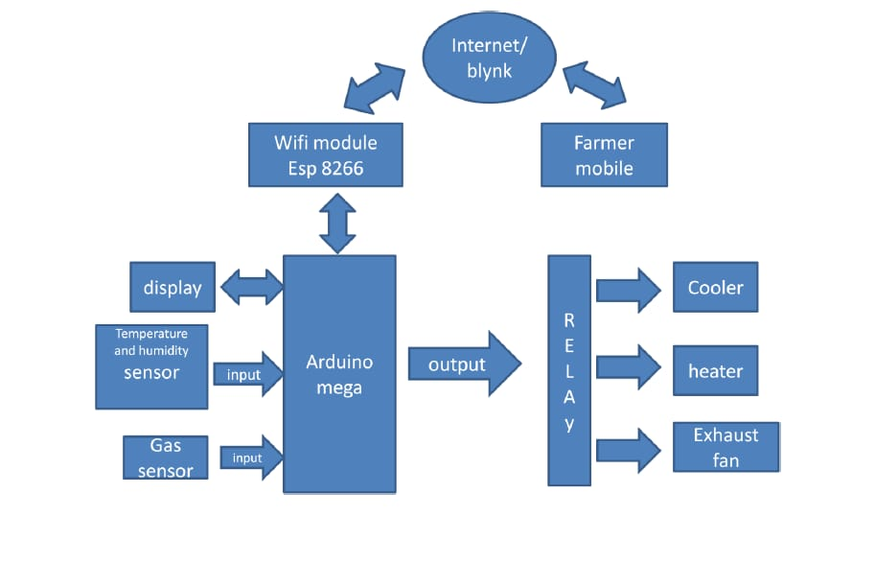
SOLUTION:
We are designing a system to monitor temperature, humidity , air quality and hazardous gases inside the silkworm shed using sensors .
It sends the sensor data to the farmer in real time(as shown in the block diagram).
When the parameters changes the device sends the notification to farmer Mobile.
It can automatically changes the parameter without farmer interaction by auto mode.
This system alerts the farmer by sending notifications as parameters changes.

Slide 5
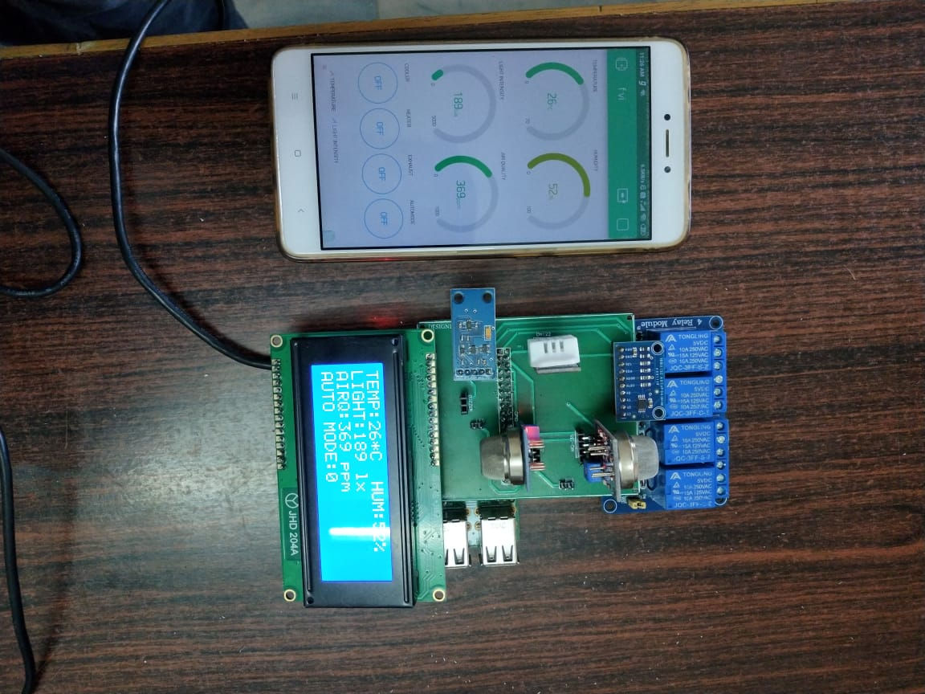
PROTOTYPE AND FUNCTIONING
Sensors interfaced with the arduino sense the temperature, humidity, air quality and sends info.
As the parameters changes the voltage in the sensors changes and sends the information to the arduino.
Arduino sends the information to ESP8266 and display .
From the ESP8266 by cloud the farmers gets the data in their mobile app.

Slide 6
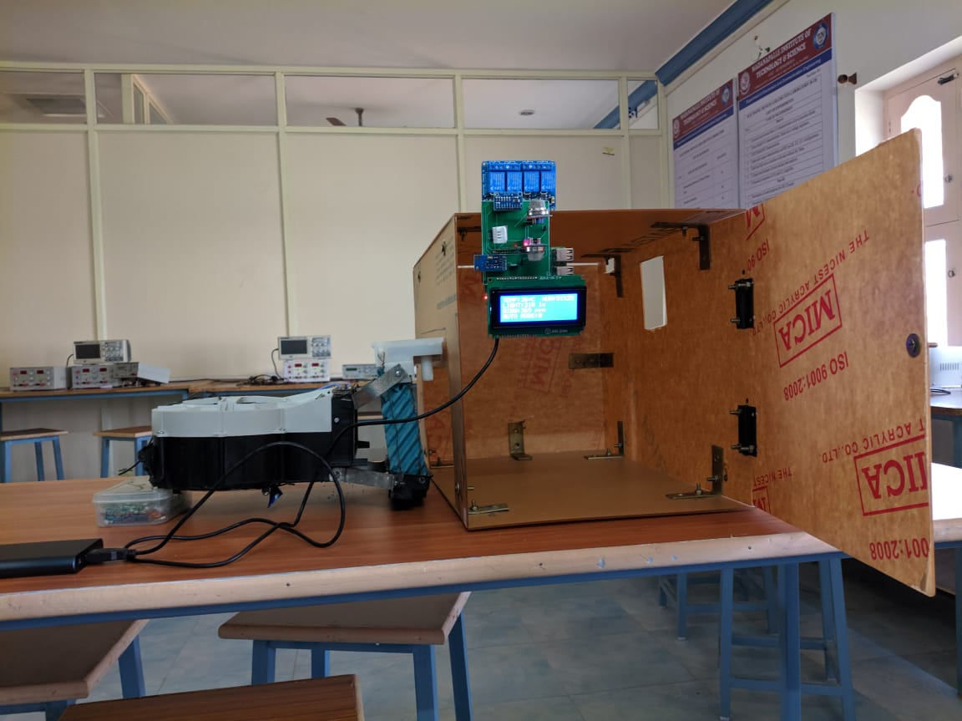
Controlling the environment
Our mobile app consists of 2 modes manual mode and auto mode for controlling the environment.
In manual mode farmer can control the parameters as the signals are transmitted to the relays which are connected with cooling and heating elements.
In auto mode the arduino takes the decision to control the parameters
There is a smoke sensor which also detects accidental fire in the shed with the emergency alarm

Slide 7
Impact of our solution
Our project is designed in such a way that a farmer’s interaction is very less.
Environmental conditions inside the shed can be monitered and controlled efficiently.
We can avoid loss of silkwarms by diseases.
Growth of the silkwarm is increased enormously which results in more profit.

Slide 8
Implementation and outreach plan
We are implementing this project in realtime (silkwarm shed) and getting feedback from the farmers
By implementing this project farmers can maintain the shed throughout the year.
We are providing a facility to farmers that they can control it from anywhere in the world through an Android application.

Slide 9
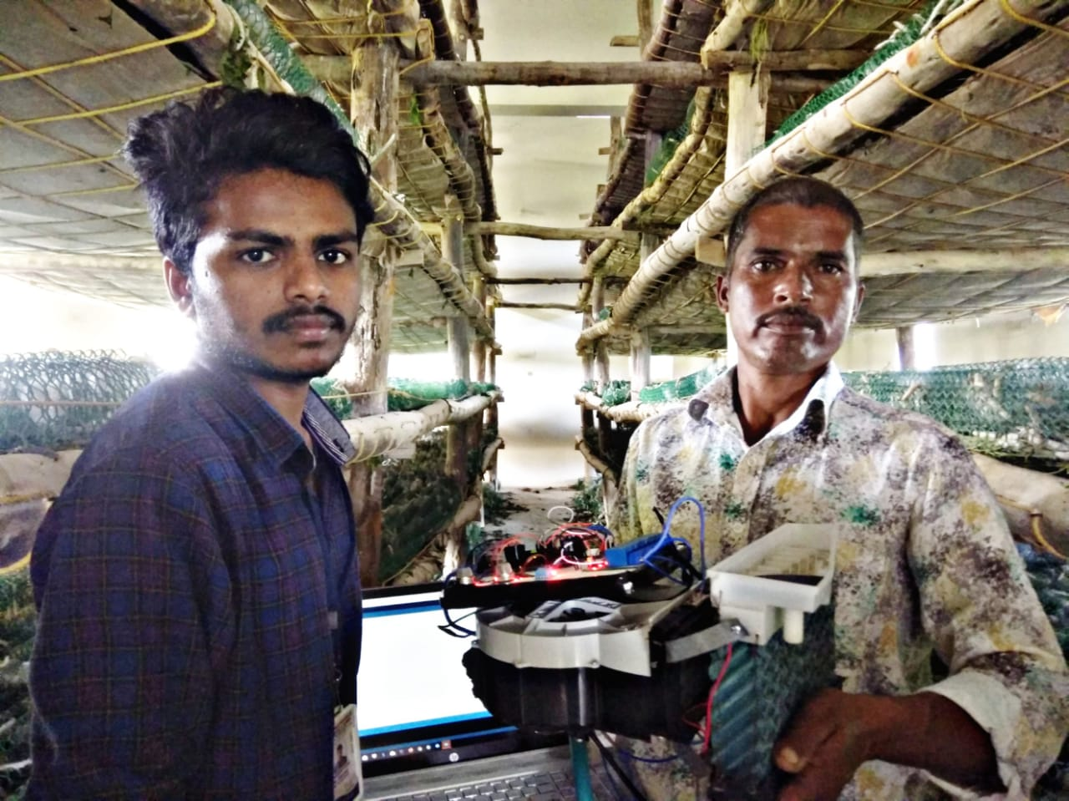
Feedback of implementation from farmer
We are able to control the diseases of silkwarms get by change in climatic conditions.
No need to go to the shed everytime to check the conditions.We can monitor from home itself.
Quality and quantity of the silkwarm is increased.
Cost effective and user friendly.
We can produce cocoons throughout the year.
Our effort is reduced and profits are increased.
It is very easy to use for illiterate farmers also.

Slide 10
Financial implication of village
Farmers can grow sillkwarms around the year. Demand of the silkwarms is constant and fluctuations in the market rate is minimal.
Farmers can make more profits than usual.
Village income is improved enormously by implementing this project.

